Slide 1
Stock price prediction based on sentiment and semantic analysis
Stock price is entirely governed by 2 factors: What the owner wants to sell it for, and what the buyer is willing to pay for it. Many factors influence their decisions. This project will focus on price prediction based on semantic analysis and sentiment analysis of social media, google search terms, and new articles over time.
The main idea here is that as people make decisions about what stock to buy and the price that they are willing to buy or sell it for, there may be predictive indicators in media publications.
Sentiment analysis using TextBlob or Vader provides a reliable metric expressing positivity, negativity, subjectivity, and sarcasm. This effort will explore the potential to establish a semantic scale of topic modeling to create a semantic score expressing a semantic score for stock valuation using BearMarket/BullMarket score. From -1 to 1.

Slide 2
Caveats
This project is still in the “develop the data sets” stage. Work in EDA and data acquisition is under way but not yet completed.
Work in data processing of extracting data, storing the data in processible forms, developing the data structure to support machine learning, etc is under way.
Some learning curves getting to this stage include:
working in GITHUB from a directory structure on a laptop. I’ve never worked in github before and there are many ways that the process breaks.
Processing queries to Google to get urls on the topic:
Several scripting efforts have been attempted including web scraping google, google developer api, researching paid api access, etc. This effort has been beset with various blocking, and unreliable scripting documentation, and aberrant search engine results.
If progress in not made soon on the google front, then a very manual effort to collect relevant urls to work with may be necessary.
Processing articles from newspaper3k package to process article collections from news sources, downloading individual articles, and parsing these into a persistent disk store to support machine learning processes in follow-on procedures.
I have a large twitter data set from a previous project that I can use if these data set acquisition processes fail to net a usable data set. The target is to have 100k to 150k articles on topic. I want published articles more than twitter data since I attribute a higher level of trust in a curated published author than an unknown credential of a twitter user.

Slide 3
What it is about, why it is important
Stock market price prediction can be lucrative if it can be done effectively and reliably. $90B of stock is traded on a daily basis in the U.S.
Establishing machine learning methods to trade stock, establish stop loss predictions, and getting in on market movements can be important commercial opportunities that a skilled data scientist can support.
Semantic scoring of this trade space is really an exercise in the utility of semantic analysis to support a useful purpose. This effort is a parallel effort for me in that I’m exploring the same methodology in 2 parallel research efforts. The second effort explores semantic scoring of customer outcomes. That effort explores using natural language and machine learning methodologies to identify customer outcomes in feedback records.

Slide 4
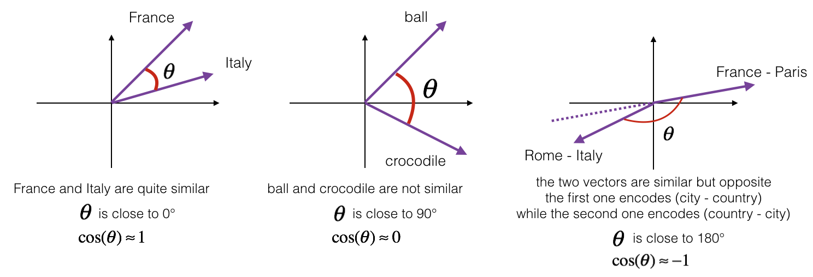
Word Vector semantic analysis
Word Vectors provide a semantic analysis opportunity to explore the relationships between words in a corpus. As word vectors are trained, the semantic relationships of words can be explored through use of distance vector math in a multi dimensional vector space. Word vectors are trained in a neural network model such that an “n” dimensional vector is created that expresses the relationship between words found in a training corpus.
Notes:
graphics source: https://datascience-enthusiast.com/DL/Operations_on_word_vectors.html

Slide 5
Cosine Similarity Vector math
The available vector math associated with word vectors provides a toolbox of methods to use in evaluating semantic relationships, but the available body of work explored in my EDA seems very sparse in generating purpose driven semantic models.
Cosine similarity math provides methods to perform linear algebra functions on word vectors and identify semantically similar words.
This is the basis of this semantic effort.

Slide 6
Neural network prediction methodology
Leveraging word vectors from various sources, use neural network prediction to isolate and score the predictive benefits of various sources. If there is a predictive relationship, then explore the feature sets and semantic relationships of the useful word vectors, authors, news sources, etc.
If a predictive word vector corpus can be isolated, then this would reflect several benefits.
Utility of the source:
News source
Author
Semantic corpus development exploring the semantic nature of knowledge, advise, opinion, etc for this particular purpose.
A semantic score of this nature could be provided in a semantic model that would be useful to inform investor decisions based on evaluation of media sources.

Slide 7
Data sources
Data sources include news articles extracted from news outlets using the newspaper3k python module.
The list is growing from an initial set of publishers I’m exploring. The list of extracted from google searches of articles exploring a time constrained search of articles published at a particular date. The top-level domain list is currently 70 sources. This effort will grow and is expected to reach to hundreds or thousands. The target article count is 150k articles.
Difficulties in learning curves accessing Google data has taken me several days and is currently still a frustration as free access including google developer API access is extremely limited and blocking has severely limited progress. Paid access may be the solution.

Slide 8
Research questions or hypotheses,
I’m very interested in the semantics of stock advice expressed by authors and people in their social media posts. What is the intent of any particular post?
Sentiment is easy to quantify, but what is the sentiment about? What was the intent of the post?
Was it informational, directive, or influencing?
What is the spectrum of intent expressed in these corpora?
How successful would predictions be if intent, and semantic modeling were included along with sentiment?

Slide 9
Research process/steps,
Once article corpus is collected, then the real work begins.
Identifying word vectors that have predictive benefits will be done by using the word vectors a feature sets in a predictive neural network.
Word2Vec provides modeling and word embeddings.
Extracting full text, lemmatized text, summary text, keyword text, bigrams, trigrams, and phrases will be part of the preprocessing effort. Storing these as word vectors.
These word vectors become feature sets for price prediction evaluation.

Slide 10
Initial EDA results
Initial data acquisition is going slowly. Accessing google to get urls of data is extremely frustrating.
Word embeddings are available using Spacy as are part of speech.
Google search results have consumed a great deal of my time attempting to gather data over time. Several API examples all result in denial of access through some means or another. Sentiment scores ate available through TextBlob
Stock prices are available through yahoo.
I’m exploring the newspaper3k package to explore news sources, and individual articles. This provides download, extraction, summarization, and nlp functions.
I’m researching vector math to see how to develop word vector cosine similarity relationships between target vocabulary
Currently there are math functions to perform vector addition, subtraction, and most similar functions or particular words in a corpus.
There is a potential to use this methodology to explore a scoring function of the existence of target words in a corpus and create an article score similar to the textBlob or Vader sentiment score.
Ideally given a large corpus training effort specifically trained on stock references, a model could be produced to be reliable in predicting the semantic intent of the author as it relates to stock price prediction domain.

Slide 11
ML models
Topic modeling, clustering, and neural network predictions of stock price based on word embeddings
Long and Short Term Memory (LSTM) recurrent neural network will be leveraged to examine the sentiment scores and word vectors of these sources to predict stock price.
The main objective for the machine learning component.
Treating the individual author as a feature in a neural network predictor such that all authors are considered over time as a discrete input, then as the neural network learns how to predict the stock price based on their content, certain authors will be more useful in those predictions than others. The hope is that the individual authors can be scored such that authors expressing advice that accurately predicts price fluctuations will be included and weighted higher or weighted lower or excluded if their advice is inaccurate. As this model is developed the hope is that the model will provide a predictive accuracy score such that expert advise can be culled from noisy media.
Developing a convolutional neural network could have better utility in that reduction of features could produce higher fidelity in intent prediction as well as utility prediction.
One problem is that the examples in convolutional neural networks seem to involve numpy array feature detection in image processing.
Can this be used to process word vectors instead of numpy arrays?
Intent prediction is intended to accurately predict the intent of the author. This would provide an intent score such that the author would be expressing advise to buy, sell, or hold.
Utility prediction would predict the relative utility of the advice on the price prediction.
Think B.S. detector.
How much can you trust or distrust the source for advice?
,

Slide 12
Expected outcomes
It is perhaps naive to assume that models created in this project will net a stable and reliable stock prediction methodology that does not require actual domain knowledge of the forces that drive stock prices. However, the methodology of evaluating investor behaviors and influencers is useful in many domains.
Focusing on news media and social media can provide access to expert and pseudo-expert advice which presumably could be used to predict stock price.
The focus shifts to modeling the predictive utility of the authors and their advice to predicted price.
Machine learning models produced would reflect a predictive score of the specific author and a semantic score of the advice.

